Slide 1
NPI´s
3M™ PELTOR™ New LiteCom Plus
Rikard Edberg

Slide 2
3M™ PELTOR™ LiteCom Plus

Slide 3
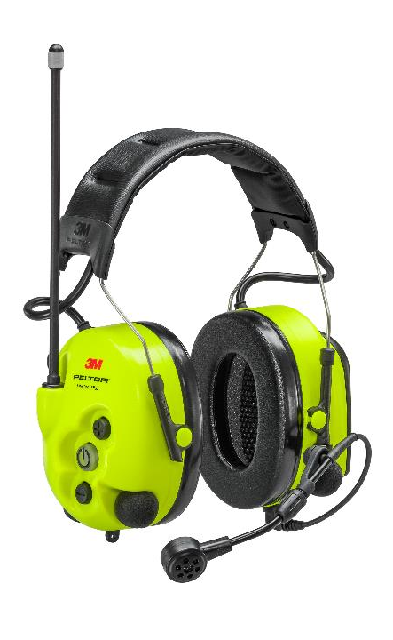
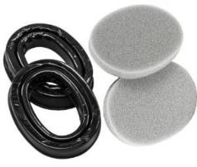

3M™ PELTOR™ LiteCom Plus – main functions
Two-way radio PMR 446
16 channels & 121 subchannels
Level-dependent function for ambient listening
Push-to-Listen
Noise cancelling boom microphone (IP68)
Voice operated transmission (VOX)
IP54 when use
Approved with gel cushion HY80
Possibility to connect external equipment with cable

Slide 4

MMI – “Man Machine Interface”
+ & - button (right cover)
On / Off & Menu Button (Right Cover)
PTT button Built-in two-way radio (Right Cover)

Slide 5
Menu system (press the On/Off button once)
Channel 1-16
Radio volume off/1-6
Ambient listening off/1-6

Slide 6
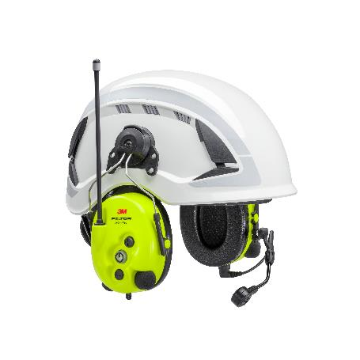
Sub Menu, press (+) and (-)
Vox Low, medium & high
Sub channel Off or any sub channel
Squelch Low, medium & high
Output power (PMR) Low & high (25/150 mW)
Language English, German, French & Espanol
Reset Go to Setup Menu (see users guide)

Slide 7
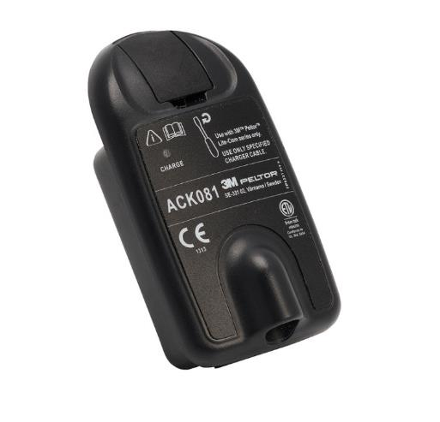
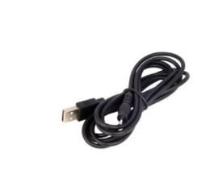
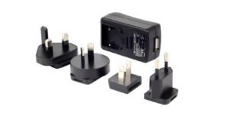
3M™ PELTOR™ ACK081 - Litium-ion battery
Rechargeable Lithium-ion Battery
Battery life: about 16 hours
3.7V / 1800 mAh / 6.7Wh
Charged with charging cable AL2AI connected to FR08 power supply
Charging time with FR08 about 4 hours
LED light on the battery will turn green when the battery is fully charged
Low battery level is indicated by a voice: "Low battery"
Charging cable
3M Peltor AL2AI
Power supply with USB
3M Peltor FR08

Slide 8

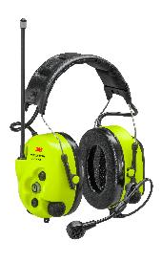
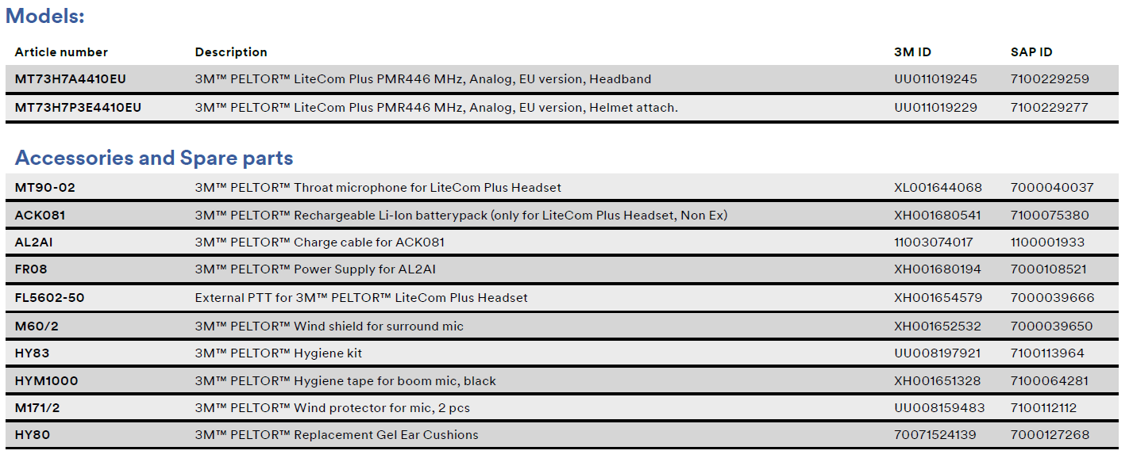
Models and Accessories

Slide 9
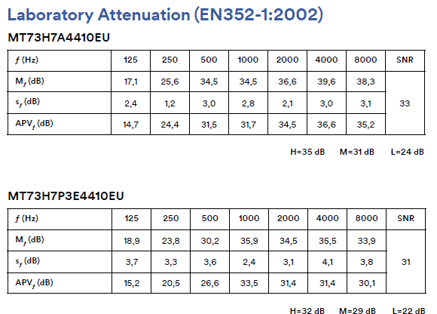
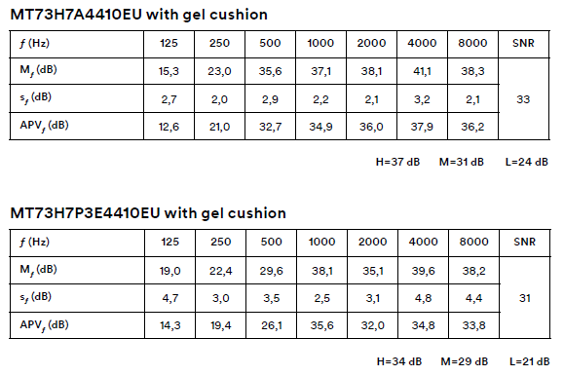
Attenuation

Slide 10

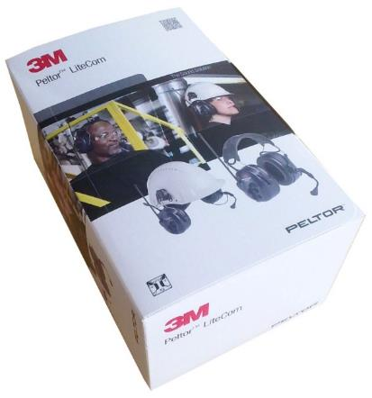
In the box
1 x 3M™ PELTOR™ LiteCom Plus Headset
1 x Battery ACK081
1 x Power supply FR08 (240 V to USB)
1 x Charging cable AL2AI
1 x Hygiene kit HY83
1 x Mic tape HYM1000-100
1 x User instruction

Slide 11

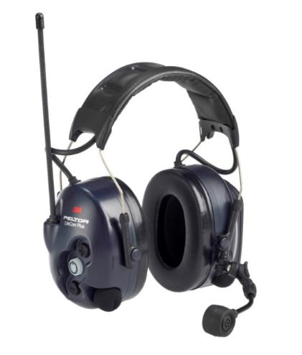
News compare to old 3M™ PELTOR™ LiteCom Plus
New color
Upgraded microphone MT73 (IP68) watertight
Push-to-Listen function
Voice menu with multiple language selection
IP54 in use
16 channels

Slide 12
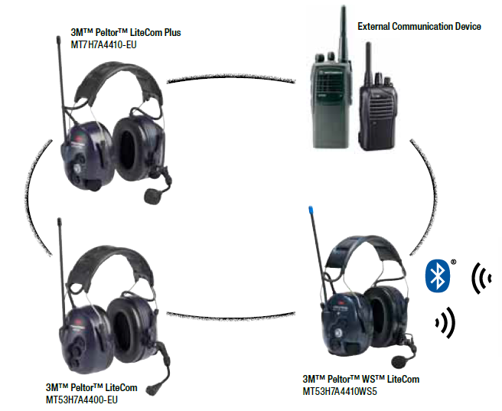
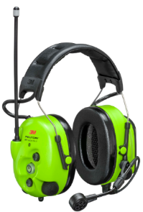

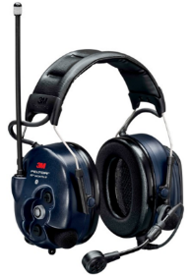

Compatibility
All 3M™ PELTOR™ LiteCom (PMR) product headsets and PMR radios can be connected
3M™ PELTOR™ WS LiteCom III GB
3M™ PELTOR™ LiteCom Plus (New)
Plus

Slide 13
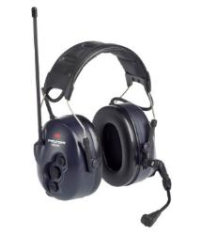



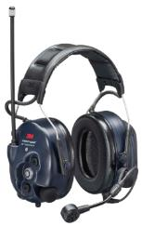










3M™ PELTOR™ LiteCom Product Family
Sold by special comms dealers
LiteCom
LiteCom Plus
WS LiteCom Plus
WS LiteCom III GB
WS LiteCom Pro III
WS LiteCom Pro III Ex

Slide 14




LiteCom Family brochure updated

Slide 15
Thank you!

